Slide 1
Sentimental Analysis by
Machine Learning
By Henry WAN Kit-Chun
&
Jimmy NG Chun-yu

Slide 2


Why Sentimental Analysis?

Slide 3
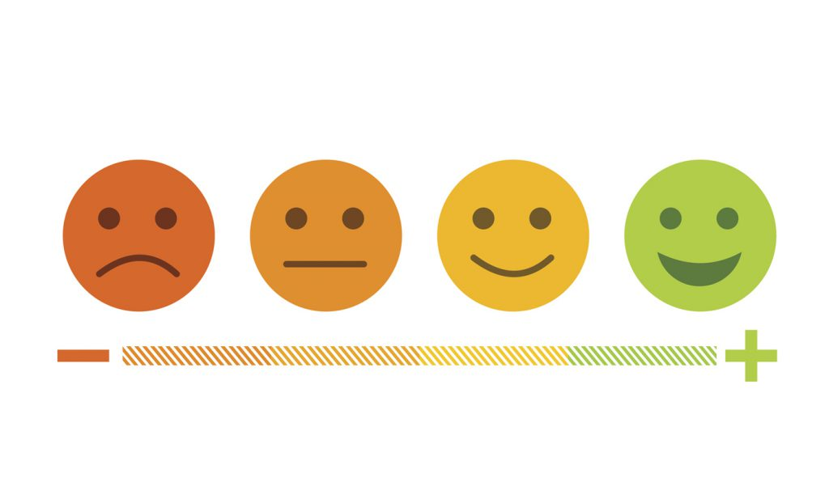
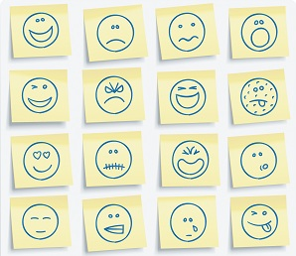
What is Sentimental Analysis?
Sentiment analysis tools generate insights into how companies can enhance the customer experience and improve customer service.

Slide 4

Our Goal
Trying to understand some alerting messages from tweets on Twitter or other social medias.

Slide 5

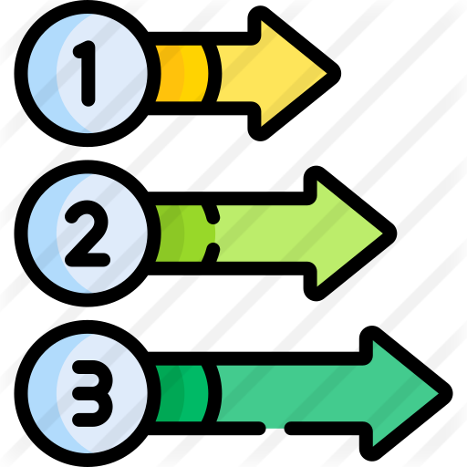
Procedures
What are we going to do?

Slide 6
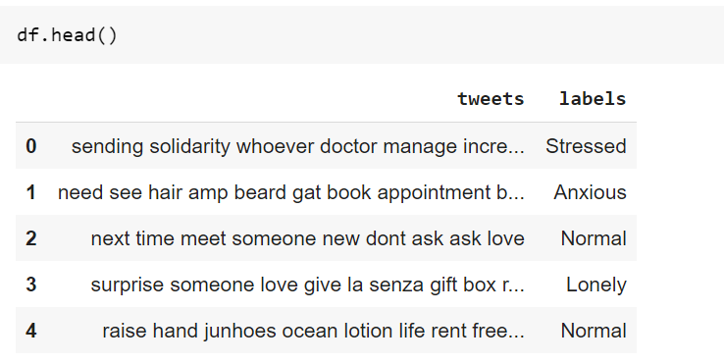
Procedures
Input The Data
and Make Them Balance
Find the suitable datasets for our purpose and then download them directly.
Then make the dataset balance.
Notes:
Download the dataset from kaggle’s competition. According to the competition, the dataset is scraped using tweets API.
The datasets contains tweets and the tweets are labelled into 4 classes, namely Anxious, Lonely, Normal and Stressed.

Slide 7
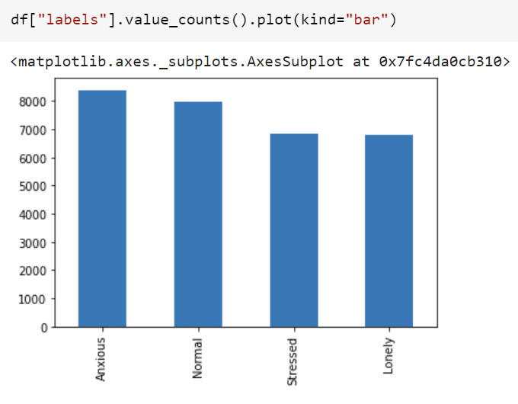
Procedures
Input The Data
and Make Them Balance
Find the suitable datasets for our purpose and then download them directly.
Then make the dataset balance.
Notes:
Download the dataset from kaggle’s competition. According to the competition, the dataset is scraped using tweets API.
The datasets contains tweets and the tweets are labelled into 4 classes, namely Anxious, Lonely, Normal and Stressed.
Here is the distribution of our dataset’s labe, our dataset is quite balanced. So, that is fine to split our dataset using simple sampling technique afterwards.

Slide 8
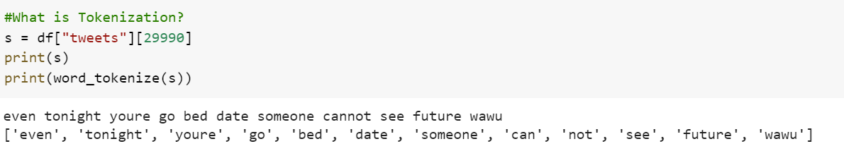
Procedures
Input The Data
and Make Them Balance
Tokenization
Notes:
So, we only have one feature (tweets) to train the model.
To let the model to understand well. We used 2 useful skills to transform the feature.
Tokenization
This is a process of breaking a stream of text up into words called tokens. The list of tokens becomes input for further processing. NLTK Library has word_tokenize to easily break a stream of text into a list of words,

Slide 9
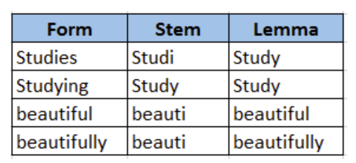
Procedures
Input The Data
and Make Them Balance
Word Lemmatization
Notes:
So, we only have one feature (tweets) to train the model.
To let the model to understand well. We used 2 useful skills to transform the feature.
This is a process of breaking a stream of text up into words called tokens. The list of tokens becomes input for further processing. NLTK Library has word_tokenize to easily break a stream of text into a list of words.
the process of grouping together the inflected forms of a word so they can be analysed as a single item, identified by the word's lemma

Slide 10
Procedures
Input The Data
and Make Them Balance
Data Pre-
Processing
Prepare Train and Test Data sets
Find the suitable datasets for our purpose and then download them directly.
Then make the dataset balance.
Transform raw data into an understandable format for NLP models.
Tokenization
Word Stemming/
Lemmatization
Split into two data sets. The training data set will be used to fit the model and the predictions will be performed on the test data set.
Notes:
And then we split dataset into train set and test set. We dont touch the test data until we finalize our model. For the training set, we implement different kinds of classification model and we did cross validation to see their performance.

Slide 11
Procedures
Input The Data
and Make Them Balance
Data Pre-
Processing
Prepare Train and Test Data sets
Label
Encoding
Find the suitable datasets for our purpose and then download them directly.
Then make the dataset balance.
Transform raw data into an understandable format for NLP models.
Tokenization
Word Stemming/
Lemmatization
Split into two data sets. The training data set will be used to fit the model and the predictions will be performed on the test data set.
Label encode the target variable.
This is done to transform Categorical data of string type in the data set into numerical values for the models.
Notes:
For the target variable, we have 4 different categorical label.
Anxious, lonely, normal, stressed
We use labelencoder model to fit and transform the label into numerical values for further modeling

Slide 12
Procedures
Input The Data
and Make Them Balance
Data Pre-
Processing
Prepare Train and Test Data sets
Label
Encoding
Word Vectorization
Find the suitable datasets for our purpose and then download them directly.
Then make the dataset balance.
Transform raw data into an understandable format for NLP models.
Tokenization
Word Stemming/
Lemmatization
Split into two data sets. The training data set will be used to fit the model and the predictions will be performed on the test data set.
Label encode the target variable.
This is done to transform Categorical data of string type in the data set into numerical values for the models.
Turn a collection of text documents into numerical feature vectors.
Term Frequency
Inverse Document Frequency
Notes:
Lastly, we transform the feature again by word vectorization.
It is a general process of turning a collection of text documents into numerical feature vectors. There are many way to do so. Here we use the most popular one called TF-IDF, stands for “Term Frequency — Inverse Document” Frequency which are the components of the resulting scores assigned to each word
TF-IDF are word frequency scores that try to highlight words that are more interesting.Firstly we fit our trainset into the model. It will help the model build a vocabulary of words which learnt from our feature. And then it will assign a unique integer to each word. Finally we transform our feature by vectorization. Which mean These will now contain for each row a list of unique integer number and its associated importance as calculated by TF-IDF.

Slide 13

Procedures
Lorem 2
Check the Quality of our Models
Lorem 3
Train Our Models
Try Different Things!
Lorem 1
Train our models by using the training data.
Naive Bayes
Support Vector Machine
Check the accuracy of our models.
Notes:
Finally, we finish our preprocessing.
And then , fit our feature into a model and then run the classification report, repeat and repeat to see which one has the BEST accuracy.

Slide 14
Naive Bayes
&
Support Vector Machine
&
Stochastic Gradient Descent
Notes:
These are the models that we was trying to fit our train set into.

Slide 15
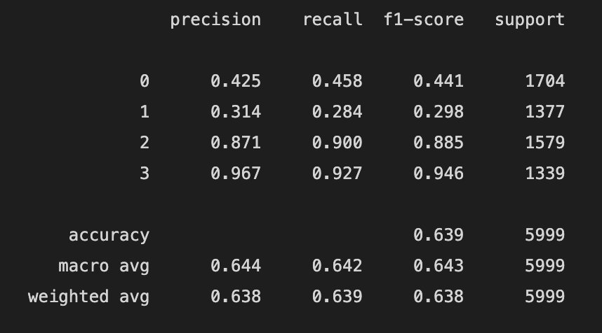
Here is what we’ve got …
0 = Anxious
1 = Lonely
2 = Normal
3 = Stressed
The models always can’t distinguish Anxious and Lonely well
But for distinguishing “Normal” or not, they are quite good !
Notes:
This classification report is the best among these three models.
You can see that our model can distinguish Normal and Stressed with a very high recall rate, which mean it can distinguish your emotion accurately if you are feeling normal or stressed. But, our model perform very badly at anxious and lonely.

Slide 16

So…this is the end of our……….

Slide 17


We could perhaps change the target…
There are obvious limitations with conventional supervised learning models on sentimental analysis.
How could we maximize the application’s value of our models?
We need to set reasonable targets for models in order to make them become useful !

Slide 18


The Models
Naive Bayes
Support Vector Machine
Stochastic Gradient Descent
Random Forest
Decision Tree
Logistic Regression
Which models are we going to use?

Slide 19
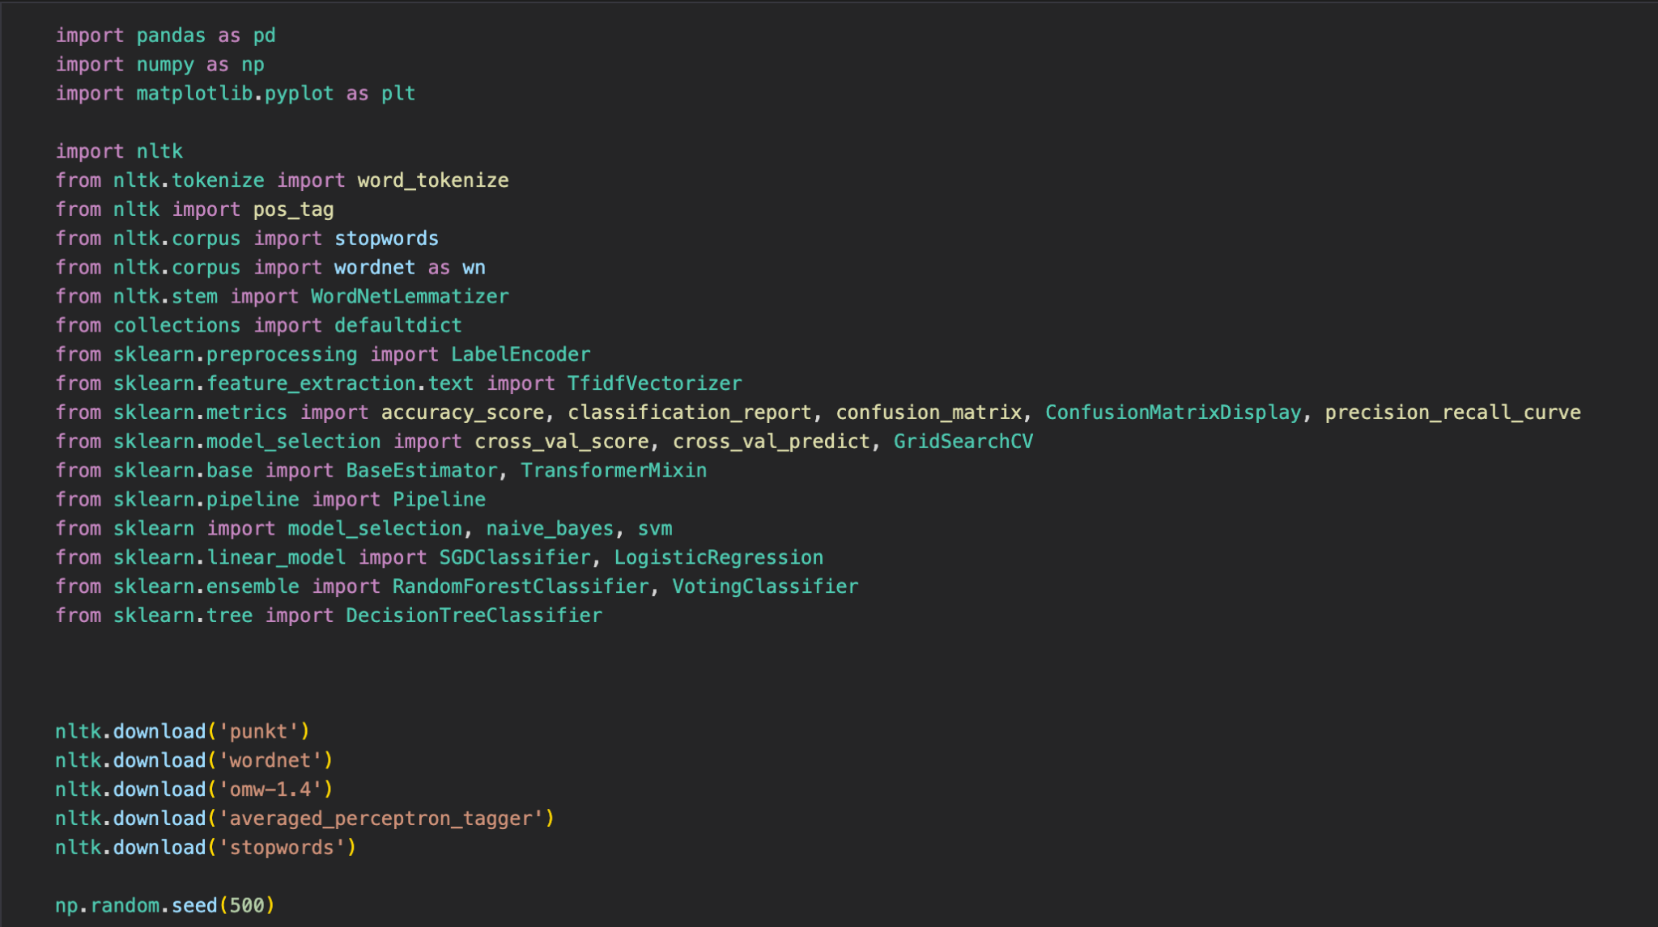
Import the Libraries

Slide 20

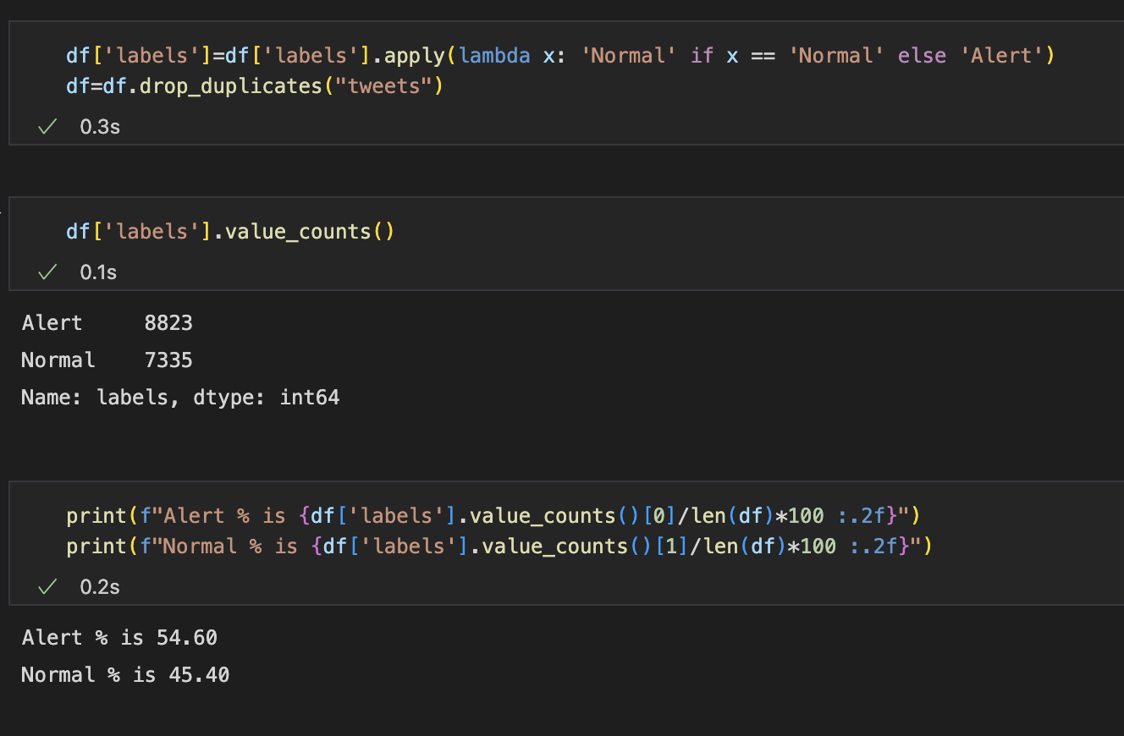
Modification of the “labels” column
As we can see, the data is approximately balance.

Slide 21
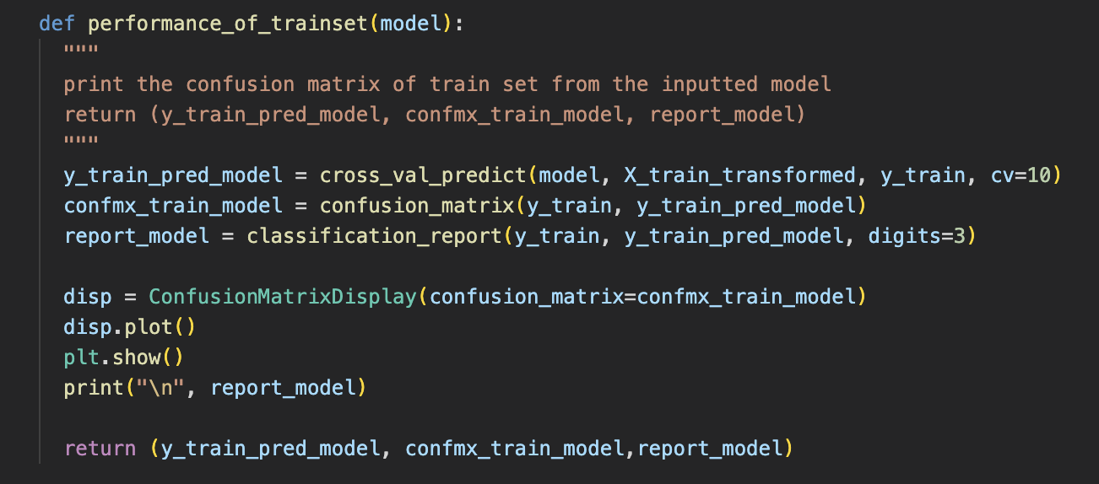

performance_of_trainset(model)
You will constantly see the result of this function as this is our function for providing insight into the models’ performance.

Slide 22
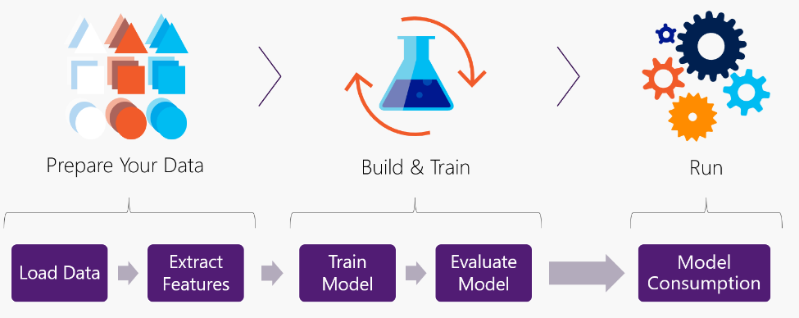
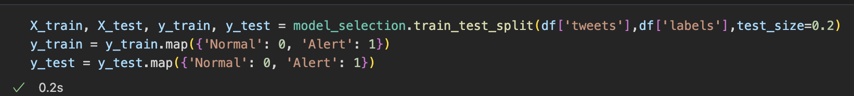
Data Preprocessing

Slide 23
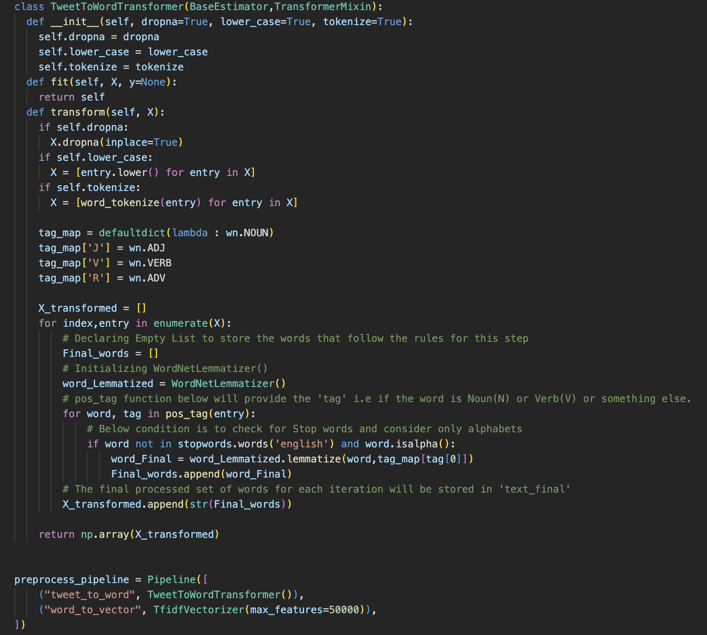
Data Preprocessing

Slide 24
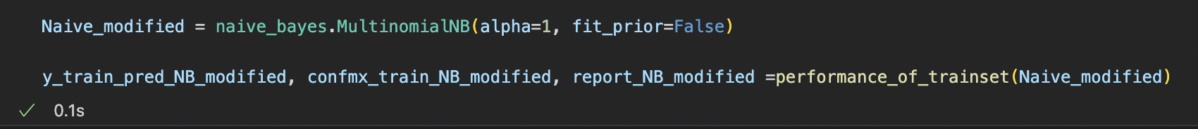
Naive Bayes
The First Model…

Slide 25
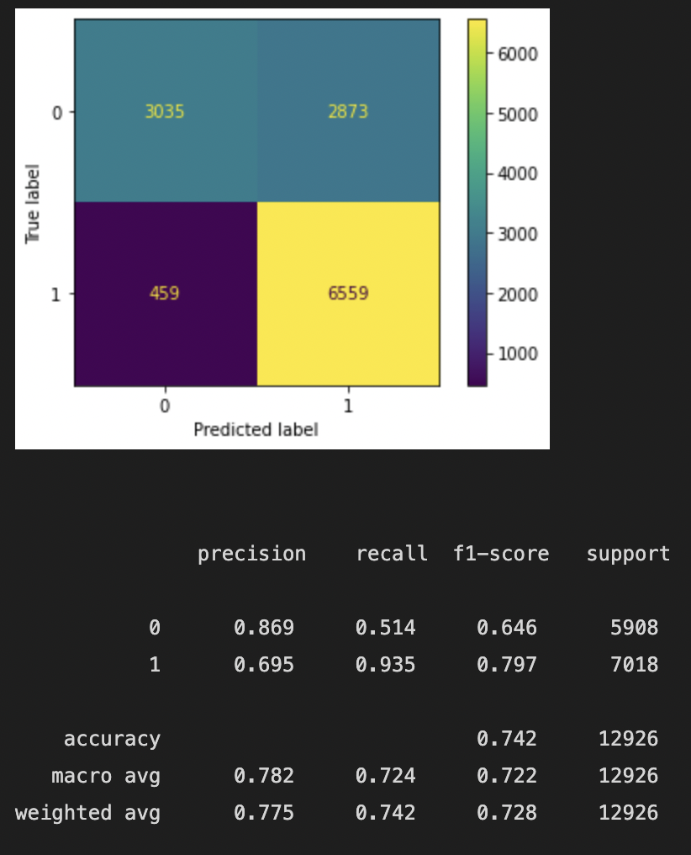
Performance of Naive Bayes
Training time for our data set: 0.1 s

Slide 26
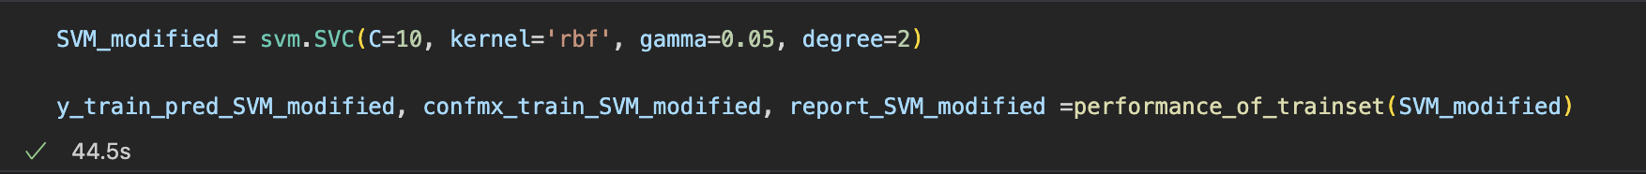
Support Vector Machine
The Second Model…

Slide 27
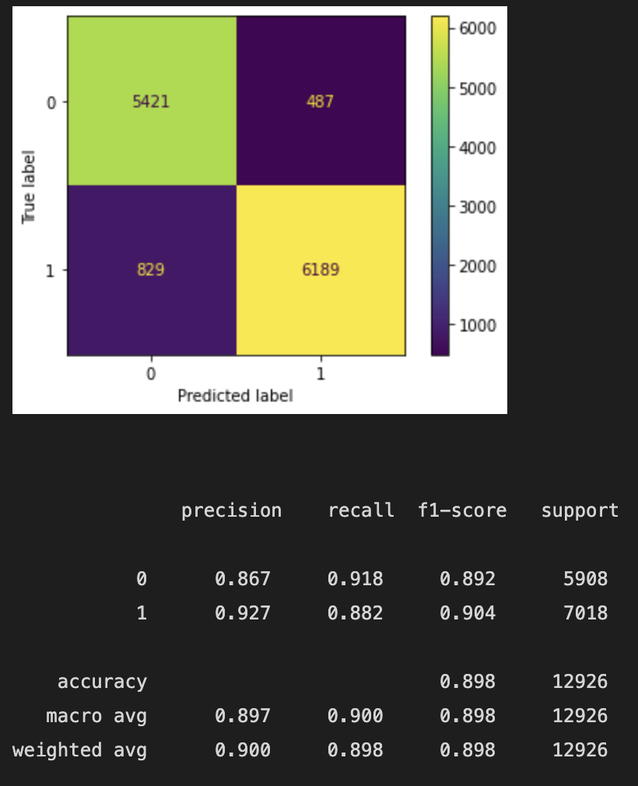
Performance of SVM
Training time for our data set: 44.5 s

Slide 28
Stochastic Gradient Descent
The Third Model…

Slide 29
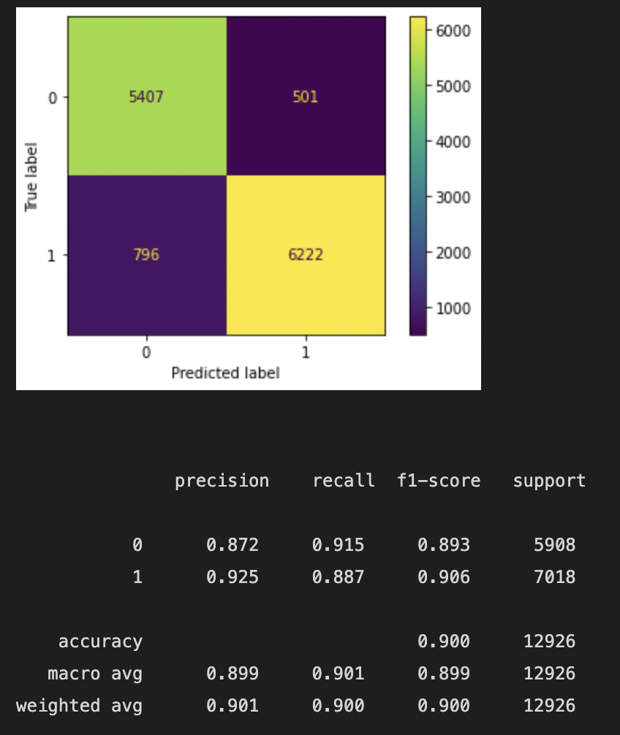
Performance of SGD
Training time for our data set: 0.8 s

Slide 30
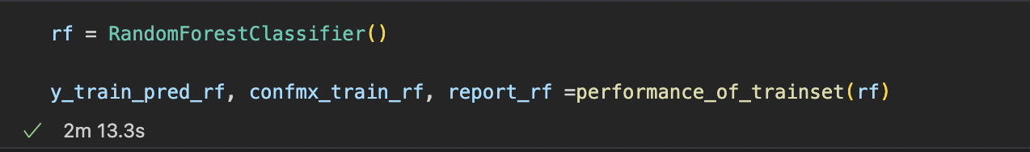
Random Forest
The Fourth Model…

Slide 31
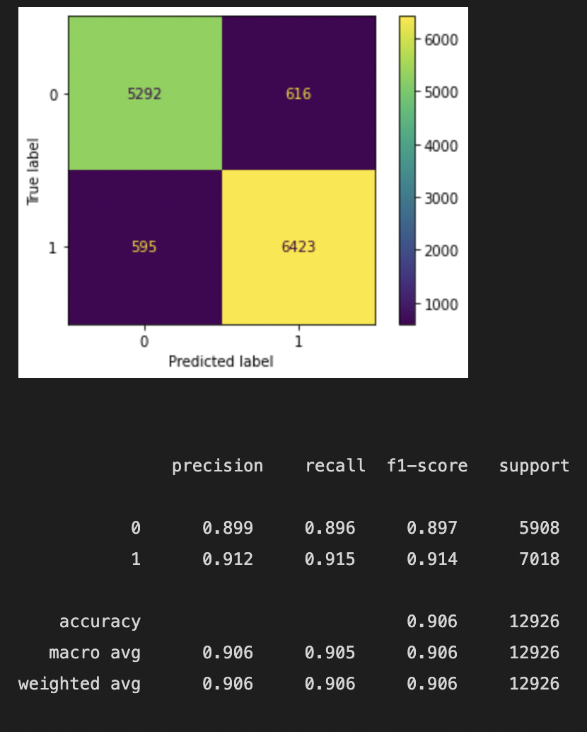
Performance of Random Forest
Training time for our data set: 2m 13.3 s

Slide 32
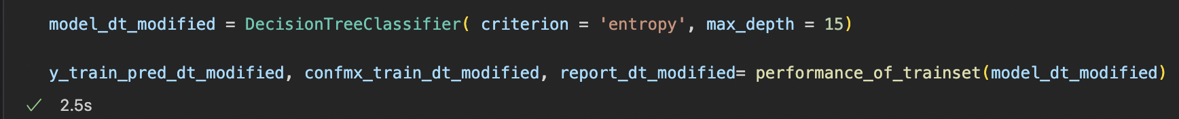
Decision Tree
The Fifth Model…

Slide 33

Performance of Decision Tree
Training time for our data set: 2.5 s

Slide 34
Logistic Regression
The Sixth Model…

Slide 35
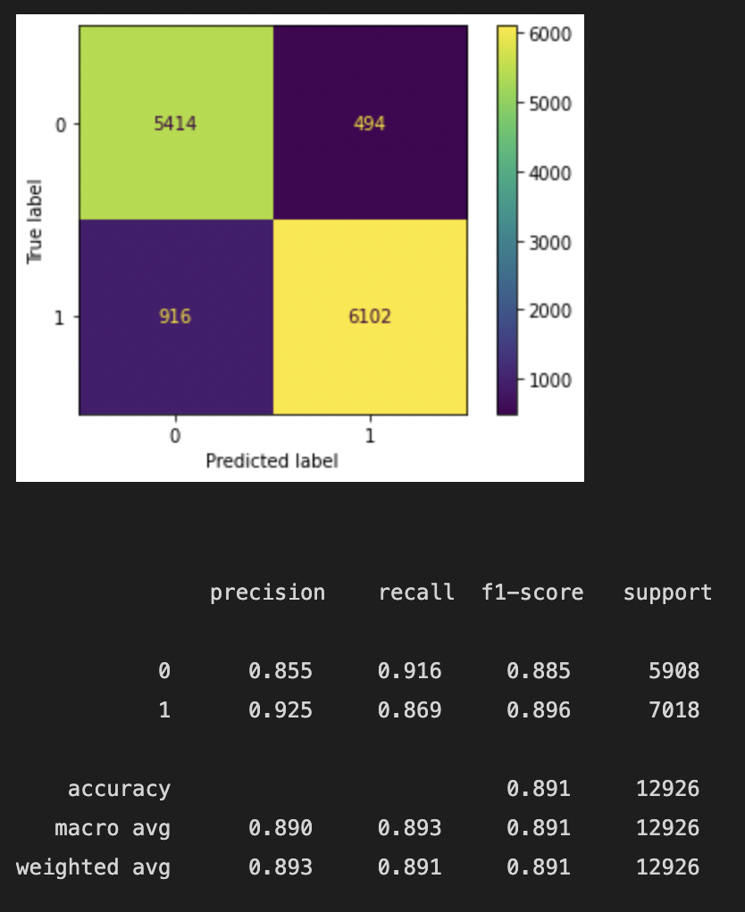
Performance of Logistic Regression
Training time for our data set: 0.7 s

Slide 36
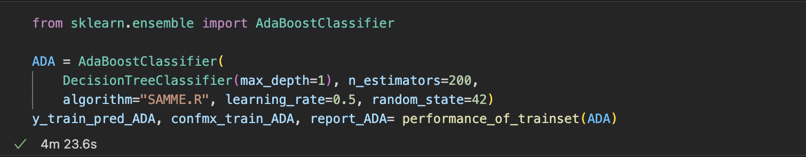
Extra:
Ada Boost

Slide 37
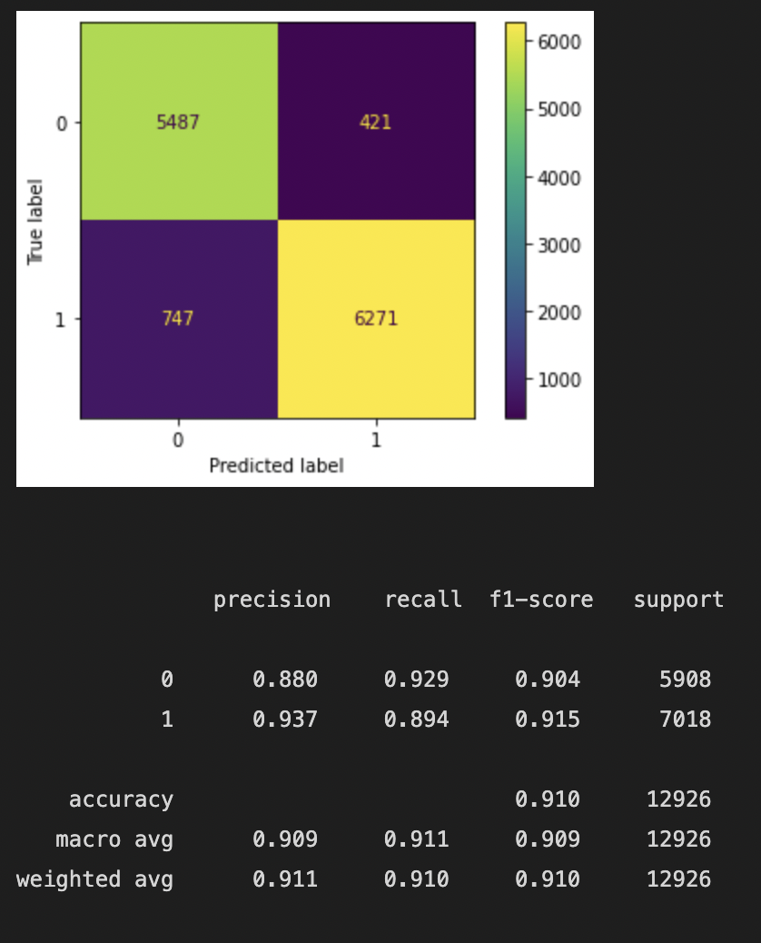
Performance of Ada Boost
Training time for our data set: 4m23.6s
Training time for our data set: 4 m 23.6 s

Slide 38
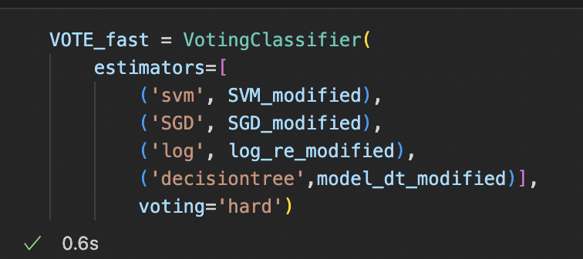
Extra:
The Voting Classifier
(‘Fast’ Version)

Slide 39
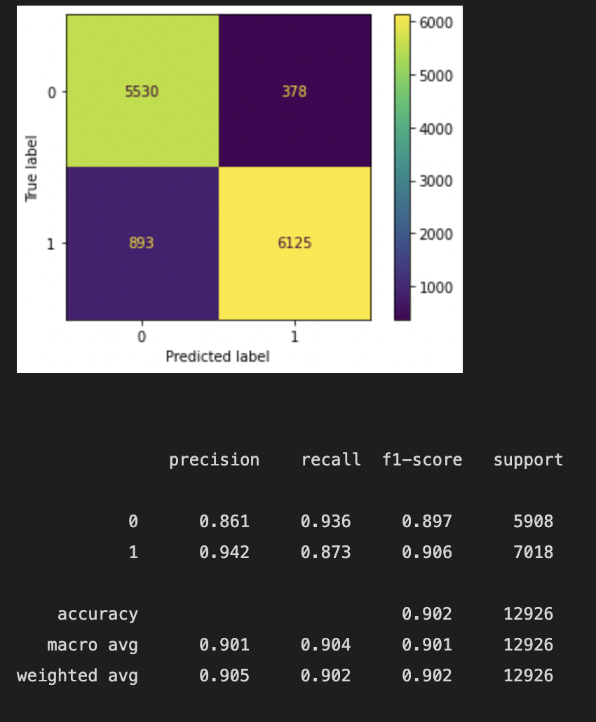
Voting (Fast)
Performance of Voting Classifier (‘Fast’ Version)
Training time for our data set: 48.8 s

Slide 40
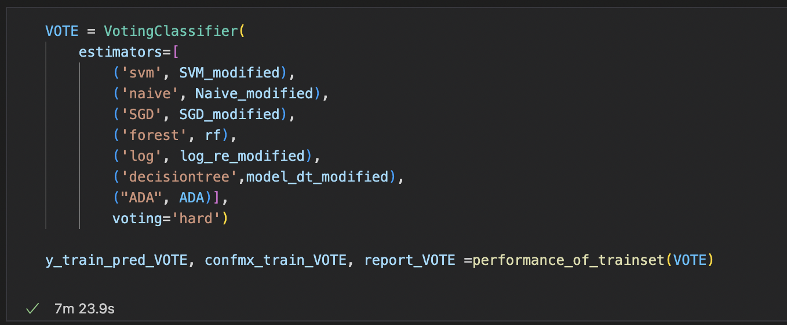
Extra:
The Voting Classifier

Slide 41
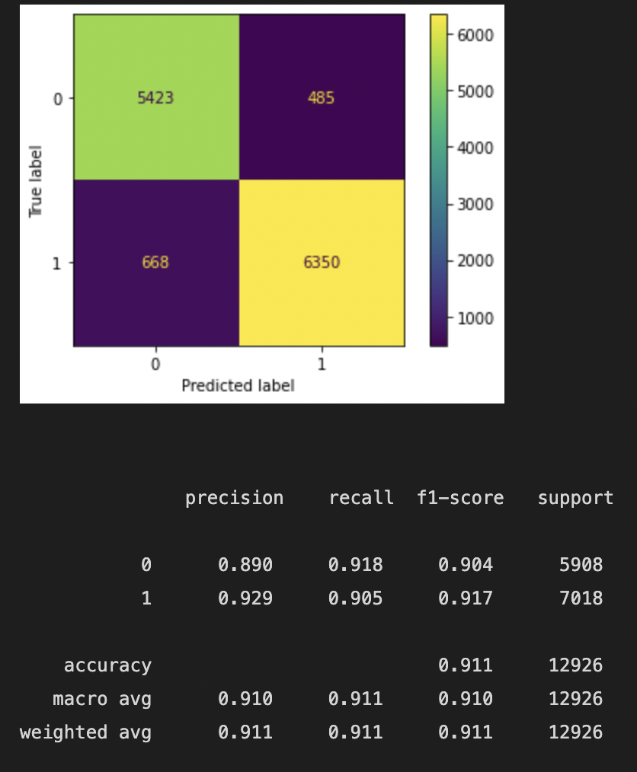
Voting
Performance of Voting Classifier (‘Fast’ Version)
Training time for our data set: 7m 23.9 s

Slide 42
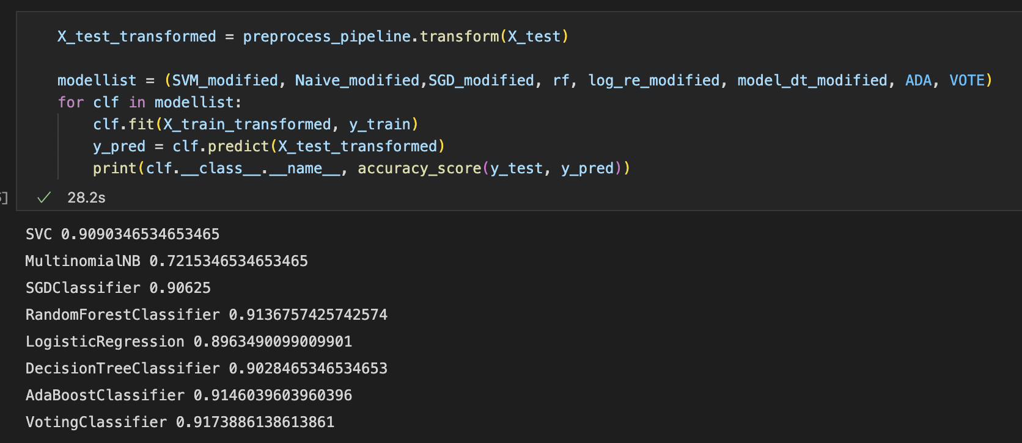
Voting Classifier
We can clearly see that NB is performing quite differently…

Slide 43
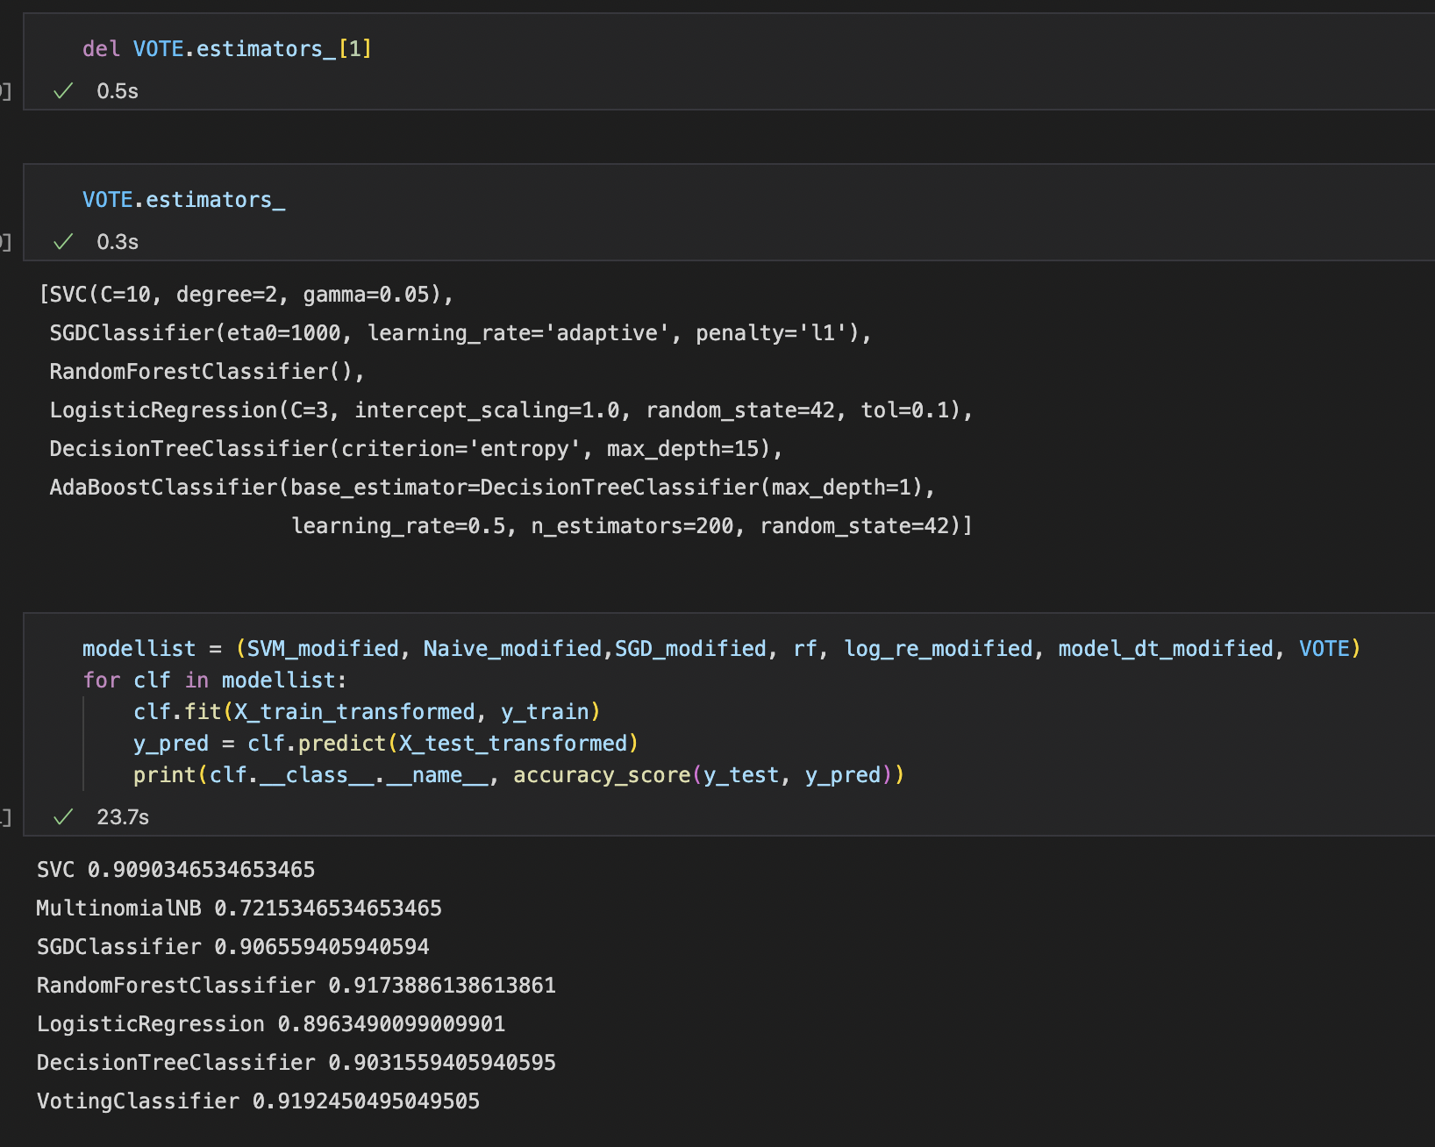
Voting Classifier
So…
We drop NB !

Slide 44
Voting Classifier
The Logistic Regression is good…
But not good enough for us
So…
Again, we try to drop Logistic Regression out of the picture

Slide 45
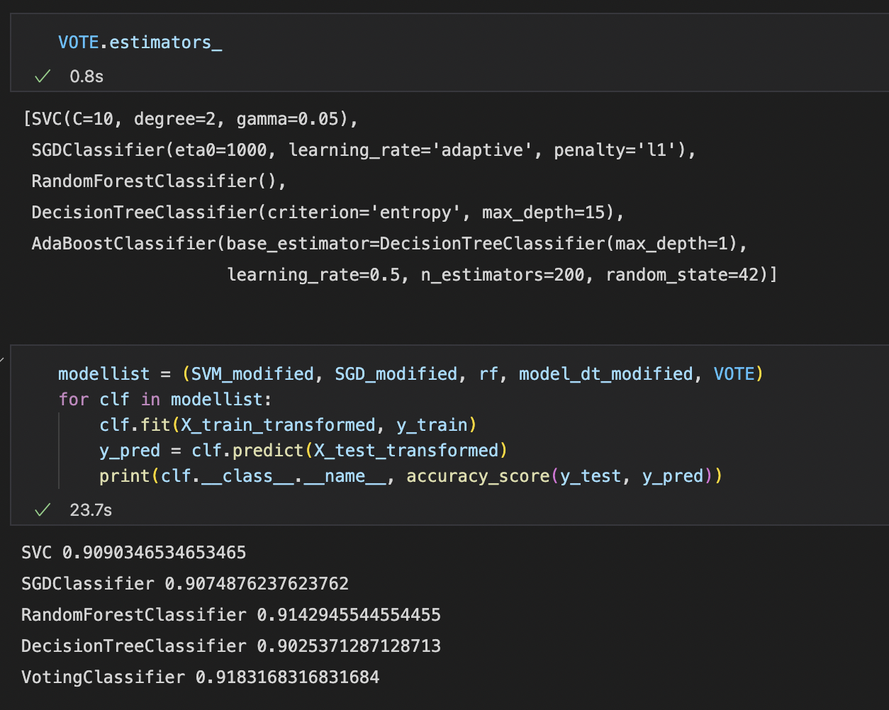
Performance of the new Voting Classifier
Without NB and Logistic Regression,
The accuracy is very high !

Slide 46

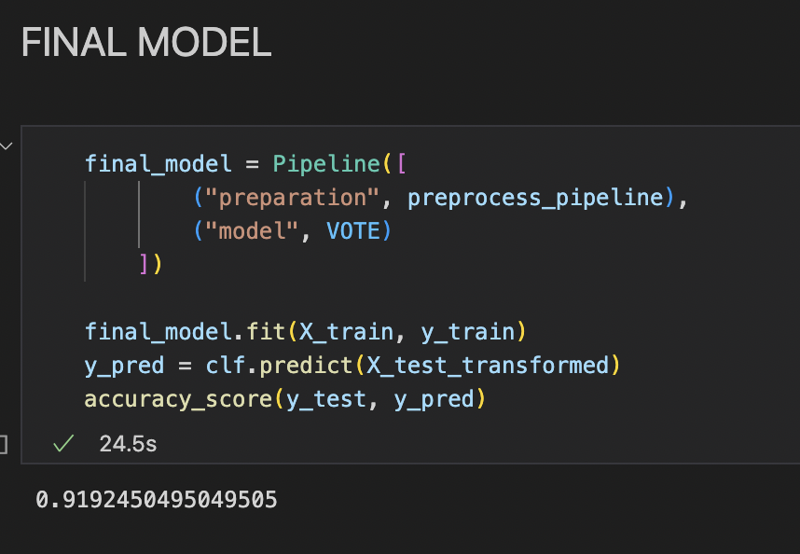

Final Model
Fast + Accurate !

Slide 47



What do we need?
Performance
Speed

Slide 48
Type of Models
Performance
Training Speed
1
Naive Bayes
The performance is not good no matter how we adjust the hyperparameter
But the training speed is really fast with acceptable performance
2
Support Vector Machine
The performance is generally good
The time for training speed of this model takes longer than the Naive Bayes while significantly faster than Random Forest
3
Stochastic Gradient Descent
Depends on the loss, but the performance is generally good
Training speed is fast
4
Random Forest
Training time is taking forever
But the performance is good
5
Decision Tree
When max_depth is under control, speed is maximize with no performance drop
Training speed is slower than Logistic Regression but still much faster than SVM
6
Logistic Regression
Fast and having good performance from the start

Slide 49


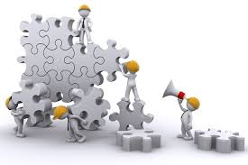
Conclusion
There are more limitations on using conventional machine learning methods.
We need to set reasonable targets.
We need to play with the datas carefully.
We need to tune the hyperparameter carefully.
We can’t wait to use Deep Learning skills in the future !

Slide 50


